Slide 1
UX DESIGN Designing for users
GROWTH SESSION

Slide 2
Why?
Create better layout for users to interact with
Spend less time in creation to focus more on interaction
Provide clear and easy-to-use components for clients
Focus on accessibility
Add better design practice to our project
Improve discovery and engagement rate from users
GROWTH SESSION

Slide 3
How?
Understand the action: Our goal is to build up a clear set of pattern to expose the right option with the right amount of details and ask for the minimal effort in return.
Encourage action: Users always come with an intent. We might know or not what is it, but we should support every viable intent.
GROWTH SESSION

Slide 4
User frustrations in 2021
Tiny scrollable panels
Tiny clicks targets
Unexpected content shifts
Unexpected page reloads
Country selector dropdown
Generic error message
Input fully cleared on errors
Disabled next button
Unsupported back button
Disabled copy-paste
No text input fallback in sliders
Draconian pass requirement
Retyping complex input
Birthday picker starting in 2021
Scrolljacking and parallax
Identifying buses/crosswalks
GROWTH SESSION

Slide 5

User delighters in 2021
Fast accessible experience
Large, legible text
Large CTA
Input boxes as input boxes
Focus and active states
Simple pass requirements
Predictable tabing in forms
Helpful error message
Smart, fast autocomplete
User input persisted on refresh
Dropdown opening on tap/click
Easy undo, edits, cancellations
Predictable back buttons
Snoozing notifications
Pausing subscriptions
Transparent pricing
GROWTH SESSION

Slide 6
Identify user need
1
1

Slide 7
“ Clearly defined boundaries and limits lead to faster designing”
GROWTH SESSION

Slide 8
Navigation priorities
Define 3 levels of priorities:
Obvious: Always present
Easy: Frequently needed
Possible: Needed sometimes (in some case)
Design both for desktop first and mobile first:
Design for touch
Consider overlay for simple nav
Use accessibility pattern
GROWTH SESSION

Slide 9
Thumb driven nav design
Thumb sweep area is limited, but we are good at shifting our grip across the back of the phone.
Central & bottom areas matter most
Target should have large padding for click purpose
GROWTH SESSION

Slide 10
Navigation checklist
What critical navigation do we always need to expose ?
Are critical CTAs optimized for mobile (float at the bottom)?
Are critical CTAs optimized for desktop (upper right corner)?
Do we always display some navigation to raise engagement?
Do we use “more/less” pattern to show/hide more navigation?
Do we display breadcrumbs to jump to the parent category?
Can we push the “menu” down to make it reachable for thumbs?
Are all navigation options reachable via keyboard on desktop/mobile?
Are all navigation options accessible via a screen reader?
Have we minimized the distance/time to travel from one step to next?
GROWTH SESSION

Slide 11
Analyze datas
2
2

Slide 12
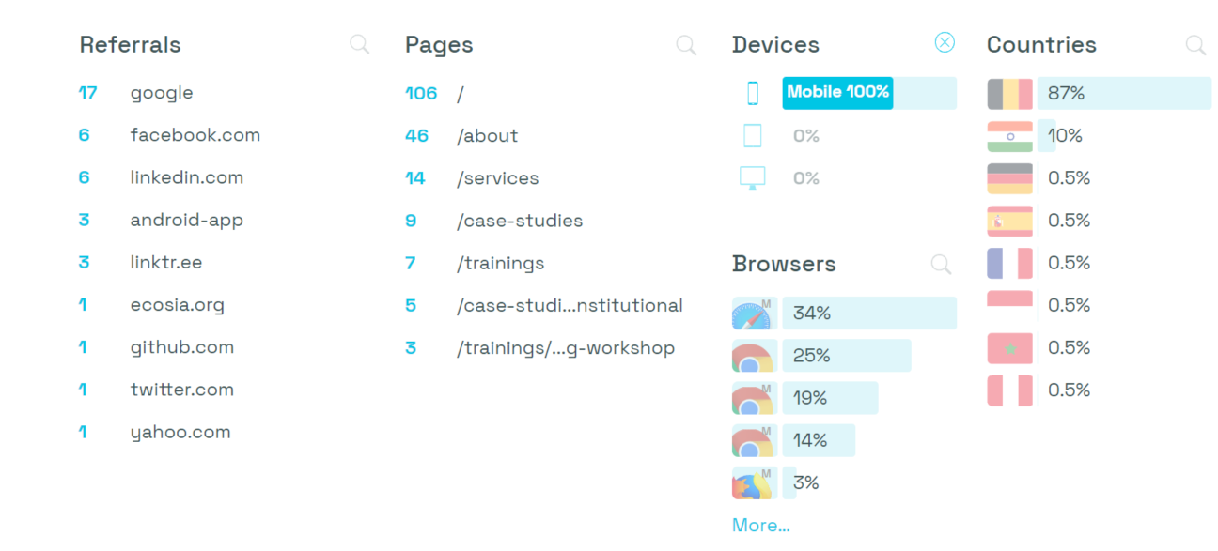
Analytics review : Mobile
GROWTH SESSION

Slide 13
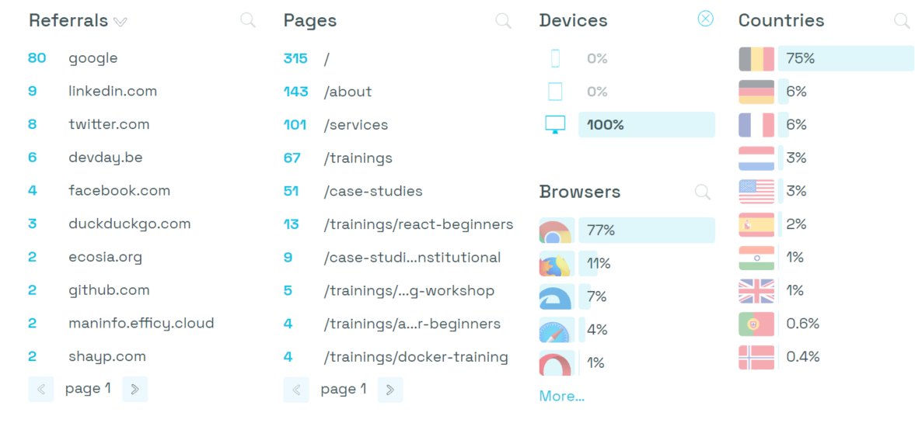
Analytics review : Desktop
GROWTH SESSION

Slide 14
Analytics review
Highlight services and quick action to get to it
Promote trainings and showcase what we propose
Clear CTA for contact section
Accessible action for mobile devices
Clear hierarchy for navigation items
GROWTH SESSION

Slide 15
Design improvments
3
3

Slide 16
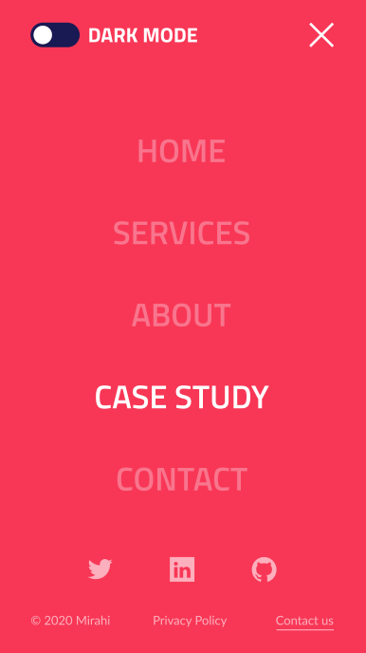
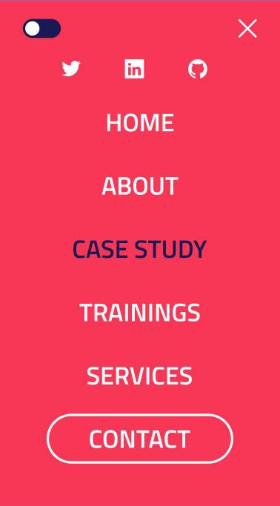
Design comparison : mobile nav opened
Put the most important CTA on the easiest reachable area (centered, near the bottom)
Create dropdown for quick access to Services & Trainings session
GROWTH SESSION

Slide 17
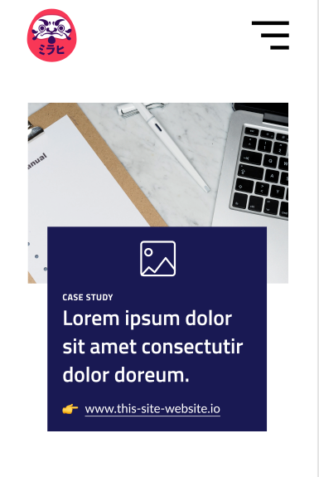

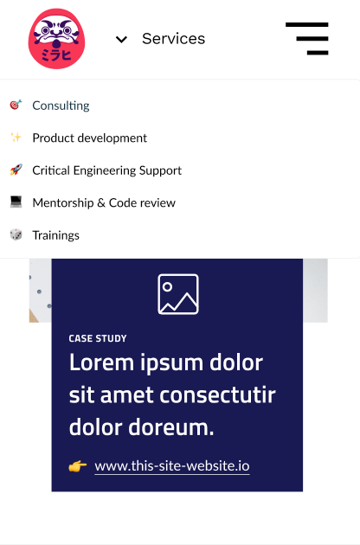
Design comparison : mobile nav dropdown
GROWTH SESSION

Slide 18
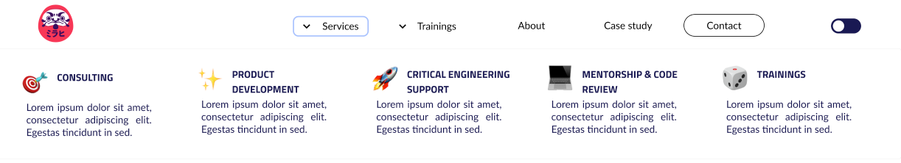
Design comparison : desktop nav
GROWTH SESSION

Slide 19
Demo
4
4

Slide 20
Conclusion
5
5

Slide 21
Key takeaways
OneDrive sync problem
Time limit
Integration of Storybook on existing product need some attention for synchronization (dependencies from Themes, Prismic, etc.)
Software knowledges (Figma, VsCode, PPT)
HTML/CSS knowledges
GROWTH SESSION

Slide 22
That’s it folks !
GROWTH SESSION

